Slide 1
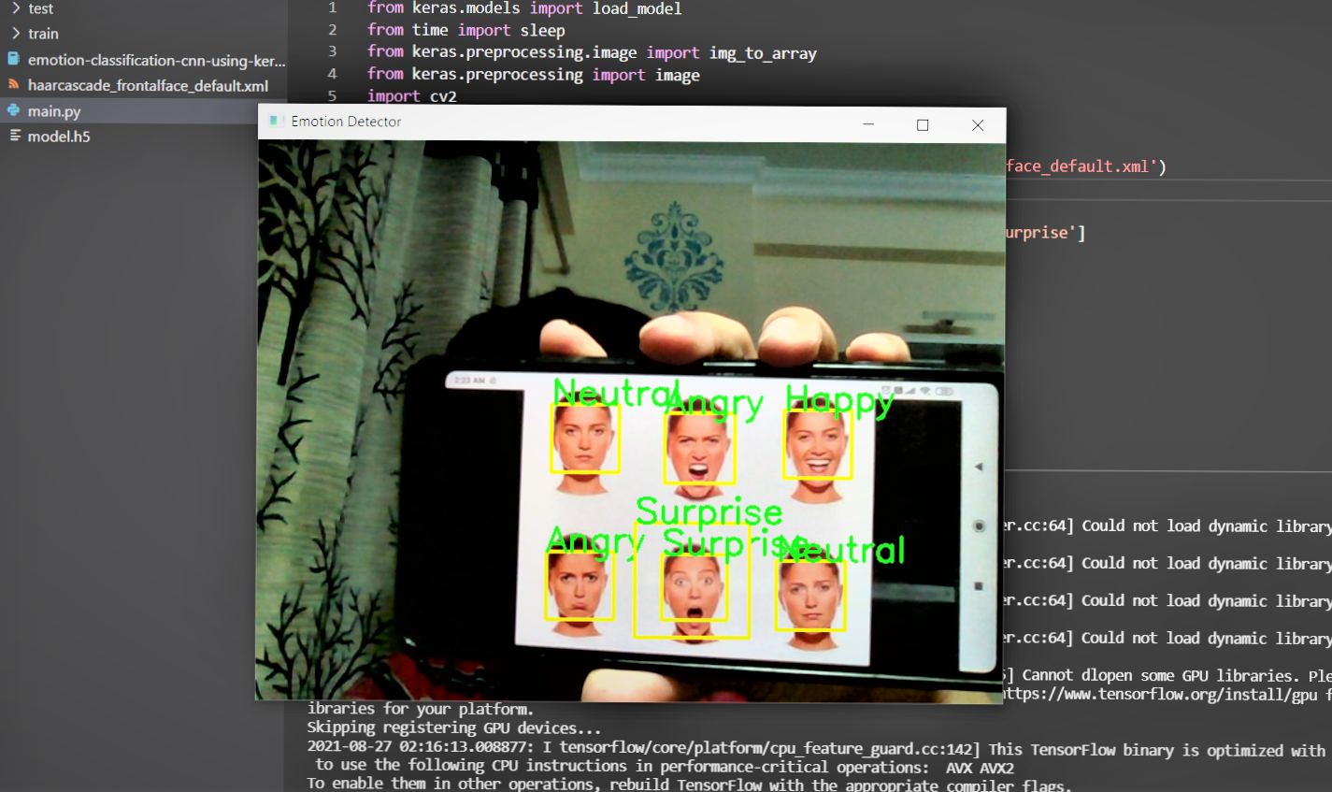
EMOTION DETECTION USING CNN
Submitted by -
Mayank Choudhary (35515002818)
Naman Tomar (35815002818)
Prashant Rana (35915002818)

Slide 2

TABLE OF CONTENTS
1. Introduction
2. Literature Survey
3. Research Gaps
4. Proposed Methodology
5. Expected Outcome
6. References

Slide 3
INTRODUCTION
The objective is to classify each face based on the emotion shown in the facial expression into one of seven categories.. We have used 7 emotions namely - 'Angry'😠, 'Disgust'🤢, 'Fear'😱, 'Happy'😇, 'Neutral'😐, 'Sad'☹️, 'Surprise'😲 to train and test our algorithm using Convolution Neural Networks
You will use OpenCV to automatically detect faces in images and draw bounding boxes around them. Once you have trained, saved, and exported the CNN, you will directly serve the trained model to a web interface and perform real-time facial expression recognition on video and image data.
For this project, you need Python, Jupyter, Tensorflow, OpenCV and Keras pre-installed. Along with data visualization libraries like numpy, panda, matplotlib, seaborn.

Slide 4
Dataset size
Train – 28821, Validation – 7066 images
Optimizers
Convolution NN Algorithm, Optimizers – Adam, RMSprop
Libraries
Deep learning libraries - Open CV, tensorflow, keras
Layers
Dense, Flatten, Activation, Conv2D, BatchNormalization etc

Slide 5







Different emotions dataset

Slide 6
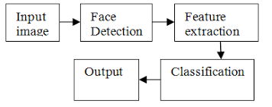
LITERATURE SURVEY
Emotion Recognition is an important area of work to improve the interaction between human and machine. Complexity of emotion makes the acquisition task more difficult. More recently, inception to the idea of multimodal emotion recognition has increased the accuracy rate of the detection of the machine. Moreover, deep learning technique with neural network extended the success ratio of machine in respect of emotion recognition. Recent works with deep learning technique has been performed with different kinds of input of human behavior such as facial expressions and body gestures. Still many aspects in this area to work on to improve and make a robust system will detect and classify emotions more accurately. In this paper, we tried to explore the relevant significant works, their techniques, and the effectiveness of the methods and the scope of the improvement of the results.

Slide 7

RESEARCH GAPS
Deep learning usually requires big data, with respect to both volume and variety. However, most remote sensing applications only have limited training data, of which a small subset is labeled.
Having analyzed both the current state of machine learning education as well as the skills needed to create important applied machine learning systems, we now comment on the gap between the two sides. Based on what classes cover and what applications require, it is clear that students are not taught enough about how to properly manage the data they are working with.

Slide 8

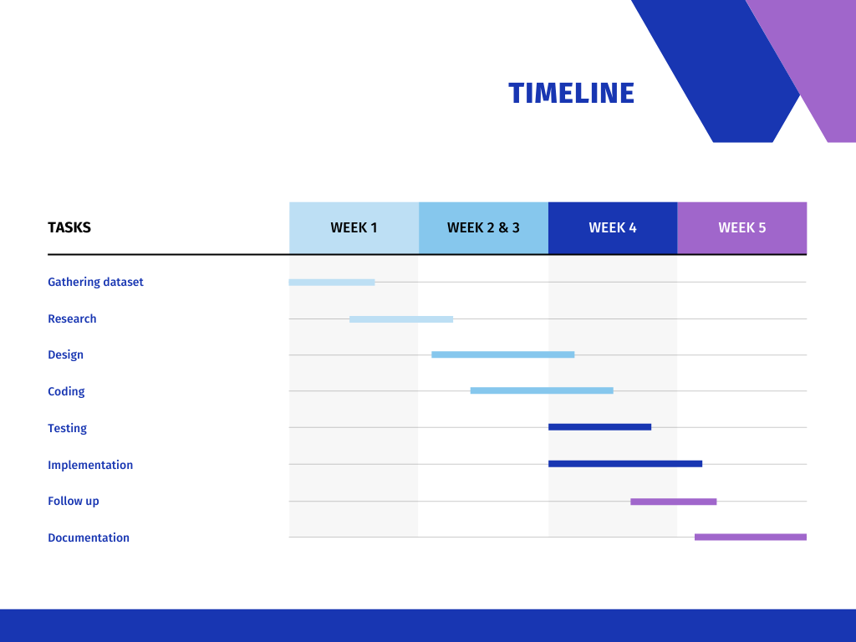
TIMELINE

Slide 9
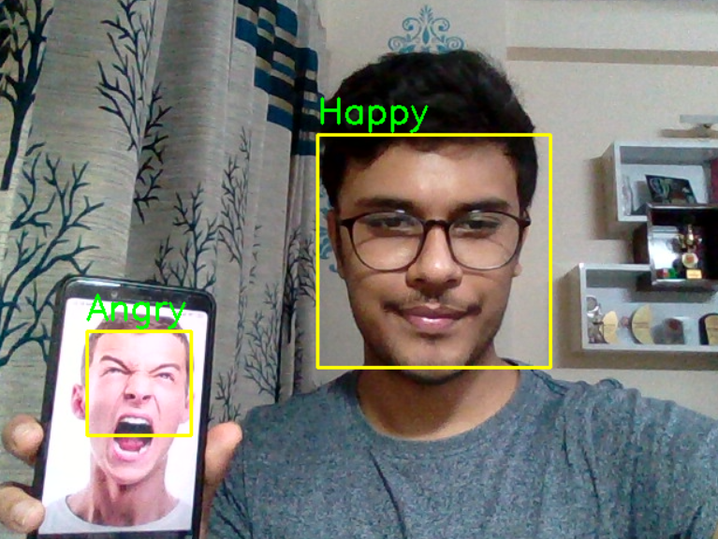
EXPECTED OUTCOME
Human emotions can be classified as: fear, contempt, disgust, anger, surprise, sad, happy and neutral using our model. These emotions are very subtle. Facial muscle contortions are very minimal and detecting these differences can be very challenging as even a small difference results in different expressions. Also, expressions of different or even the same people might vary for the same emotion, as emotions are hugely context dependent. While we can focus on only those areas of the face which display a maximum of emotions like around the mouth and eyes, how we 2 extract these gestures and categorize them is still an important question. Neural networks and machine learning have been used for these tasks and have obtained good results. Machine learning algorithms have proven to be very useful in pattern recognition and classification. The most important aspects for any machine learning algorithm are the features. In this paper we will see how the features are extracted and modified for algorithms like Support Vector Machines. We will compare algorithms and the feature extraction techniques from different papers. The human emotion dataset can be a very good example to study the robustness and nature of classification algorithms and how they perform for different types of dataset. Usually before extraction of features for emotion detection, face detection algorithms are applied on the image or the captured

Slide 10
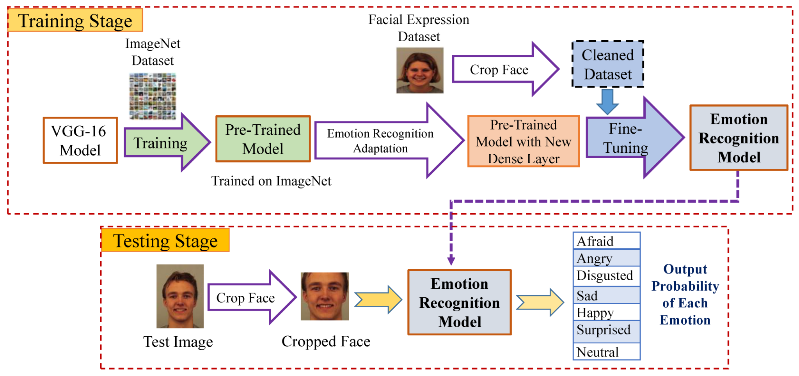


Slide 11
Data Visualization and deep learning Libraries
Programming Language - Python 3.x
Convolution NN Algorithm
Image Processing - Open CV, tensorflow
Open-source software library - Keras

Slide 12
References
Coursera - Convolution Neural Networks
Kaggle Kernel
Google Images
towarsdatascience
github
https://www.kaggle.com/jonathanoheix/face-expression-recognition-dataset
https://en.wikipedia.org/wiki/Facial_expression_databases
https://analyticsindiamag.com/top-8-datasets-available-for-emotion-detection/
https://www.coursera.org/projects/facial-expression-recognition-keras
https://towardsdatascience.com/face-detection-recognition-and-emotion-detection-in-8-lines-of-code-b2ce32d4d5de#:~:text=Facial%20Recognition%20%E2%80%94%20Compare%20multiple%20faces,neutral%2C%20surprise%2C%20disgust%20or%20fear
https://link.springer.com/chapter/10.1007/978-3-319-04960-1_27

Slide 13
Thankyou

